Slide 1
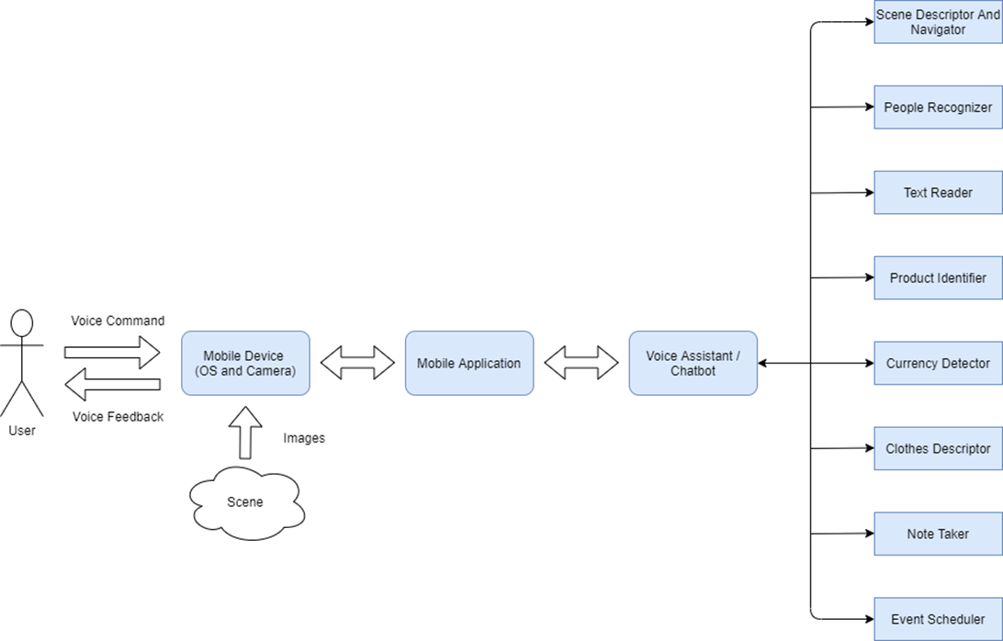
Pocket Lens GP 1 Presentation
Team #2 members:
Moaaz Mohamed Elsherbini 1180528
Mostafa Ashraf Ahmed 1180406
Nader Youhanna Adib 1180477
Ahmed Mohamed Ismail 1180501

